Slide 1




IBM HR Analytics Employee Attrition
Hello! We Are :
Kiran Raj Karthi S.
Hameed I.
Harshini S.
Akhila J.

Slide 2
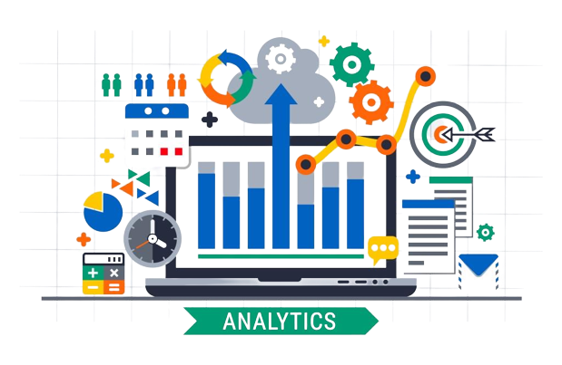
WHY THIS?
An Introduction to ‘HR Analytics’
It’s the process of collecting and analyzing Human Resource (HR) data in order to improve an organization’s workforce performance.
What is its need?
Once organized, compared and analyzed, this raw data provides useful insight.They can help answer questions like the ones we’ve picked further.
Notes:
The process can also be referred to as talent analytics, people analytics, or even workforce analytics.
-
Unfortunately, raw data on its own cannot actually provide any useful insight. It would be like looking at a large spreadsheet full of numbers and words

Slide 3
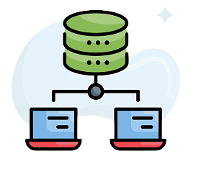
ABOUT THE DATA SET
Data Types Age int64 Attrition object BusinessTravel object DailyRate int64 Department object DistanceFromHome int64 Education int64 EducationField object EmployeeCount int64 EmployeeNumber int64
EnvironmentSatisfaction int64
Gender object WorkLifeBalance int64
YearsAtCompany int64
YearsInCurrentRole int64
YearsSinceLastPromotion int64
YearsWithCurrManager int64
dtype: object
Data Types
HourlyRate int64
JobInvolvement int64
JobLevel int64
JobRole object
JobSatisfaction int64
MaritalStatus object
MonthlyIncome int64
MonthlyRate int64
NumCompaniesWorked int64
Over18 object
OverTime object
PercentSalaryHike int64
PerformanceRating int64
RelationshipSatisfaction int64
StandardHours int64 StockOptionLevel int64
TotalWorkingYears int64
TrainingTimesLastYear int64
Rating
Education
1 'Below College'
2 'College'
3 'Bachelor'
4 'Master'
5 'Doctor'
EnvironmentSatisfaction
1 'Low'
2 'Medium'
3 'High'
4 'Very High'

Slide 4
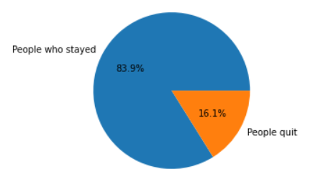
ABOUT THE DATA SET - OVERVIEW

Slide 5
IS IT ALL ON INCOME?
1
Let’s start with the first question that pops up in our head…

Slide 6
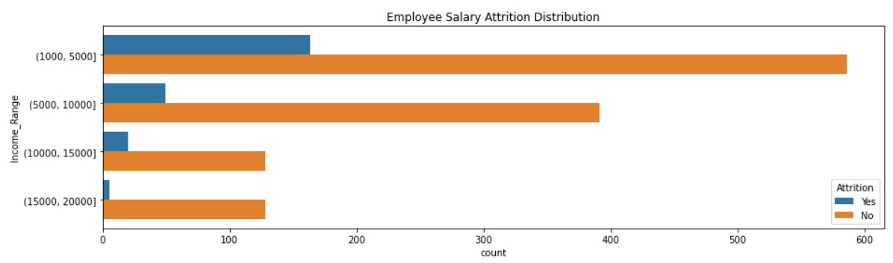
Employee Salary Attrition Distribution

Slide 7
Does work tenure matter?
2

Slide 8
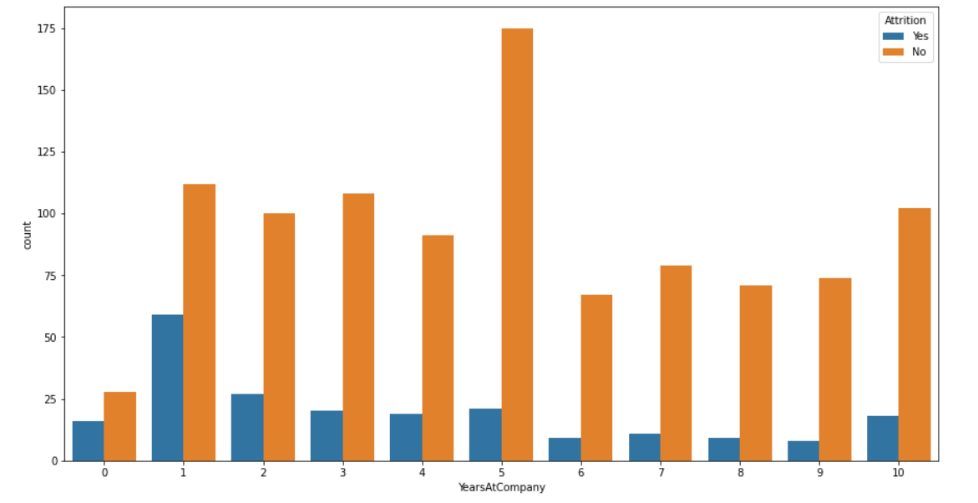
Number of years worked for the company vs Attrition

Slide 9
DISTANCE FROM HOME
3
Commuting long hours for work

Slide 10
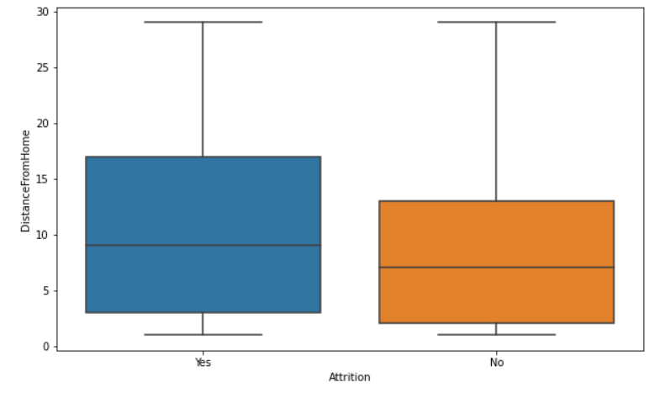
Distance from Home vs Attrition Distribution

Slide 11
WORK LIFE BALANCE
4
Let’s start analyse it!

Slide 12
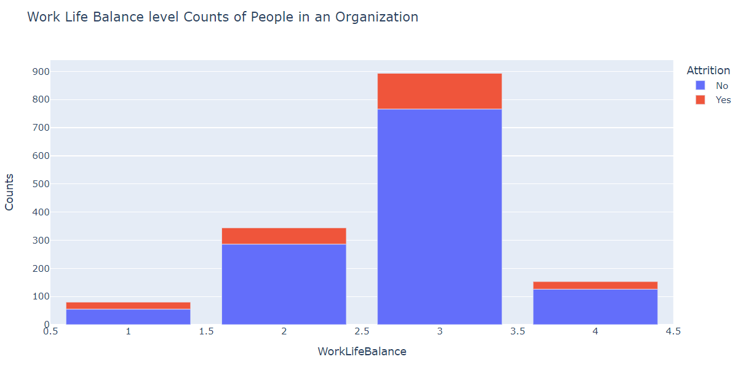
Attrition Distribution vs Work Life Balance

Slide 13
IS AGE A FACTOR?
5
Maybe? Let’s have a look at our data..

Slide 14
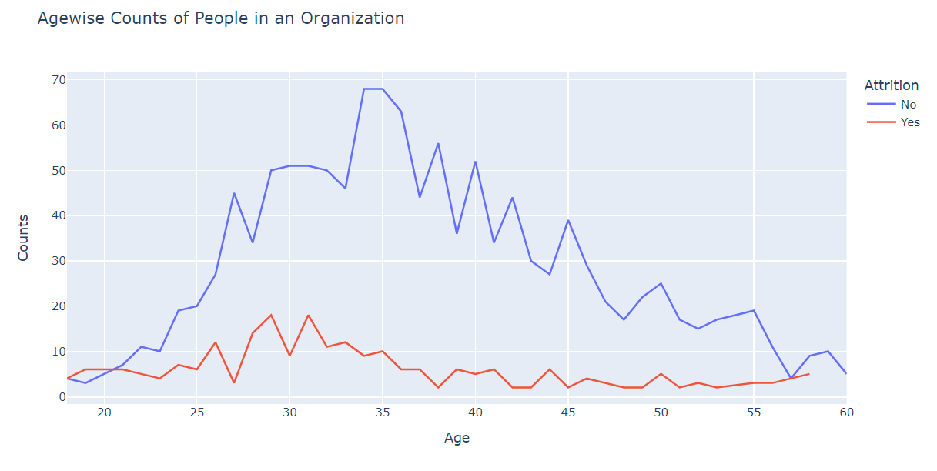
Attrition Counts vs Age

Slide 15
CORRECTIONAL MATRIX
6
Let’s explore the correlation between the elements!!

Slide 16
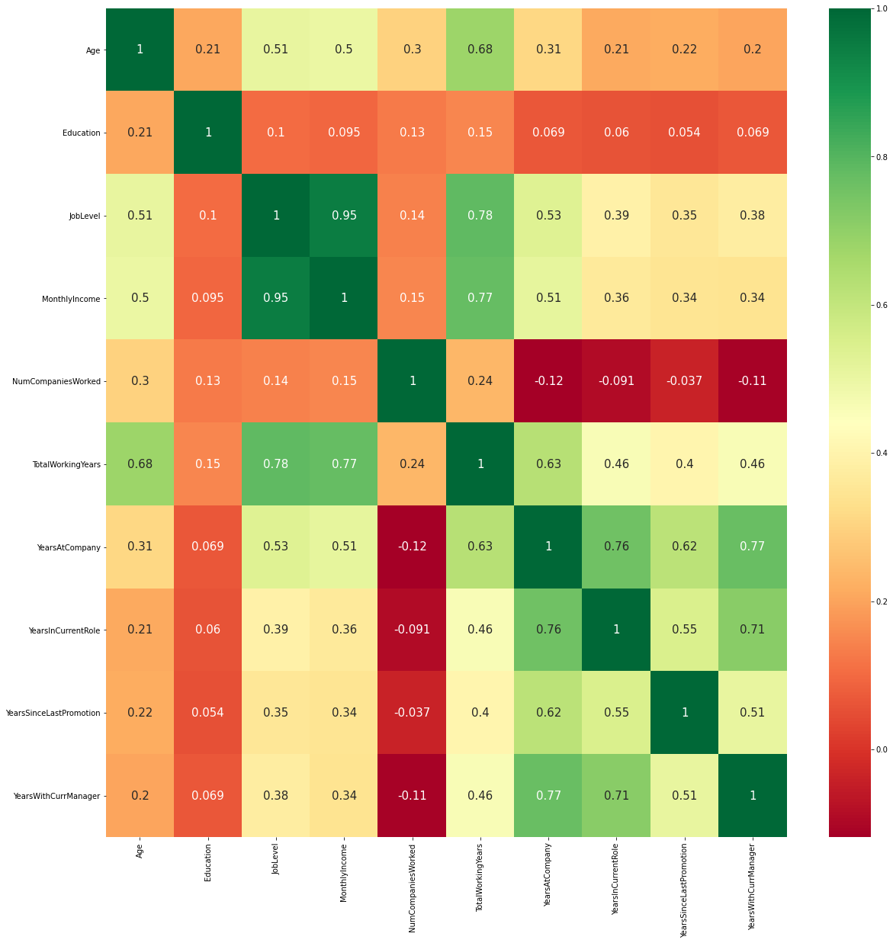
CORRELATION
MATRIX

Slide 17

A WALK-THROUGH
Additional
https://github.com/hameedibrh/tempgitaugust2022/blob/master/Sprint2.ipynb
Taking you all on a tour of our code…

Slide 18
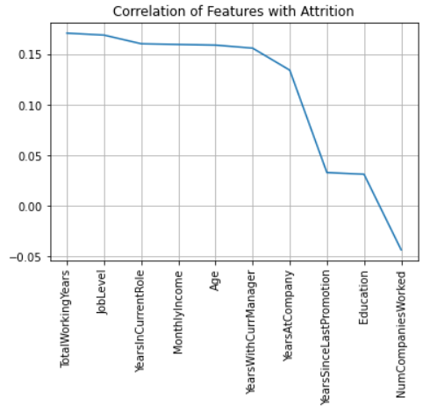
CONCLUSION

Slide 19
CONCLUSION
Total Working Years
Job Level
Years In Current Role
Monthly Income
Age

Slide 20

THANK YOU :)
Any Questions?

